Slide 1
MM6
By Charlie Curedale-rayner

Slide 2
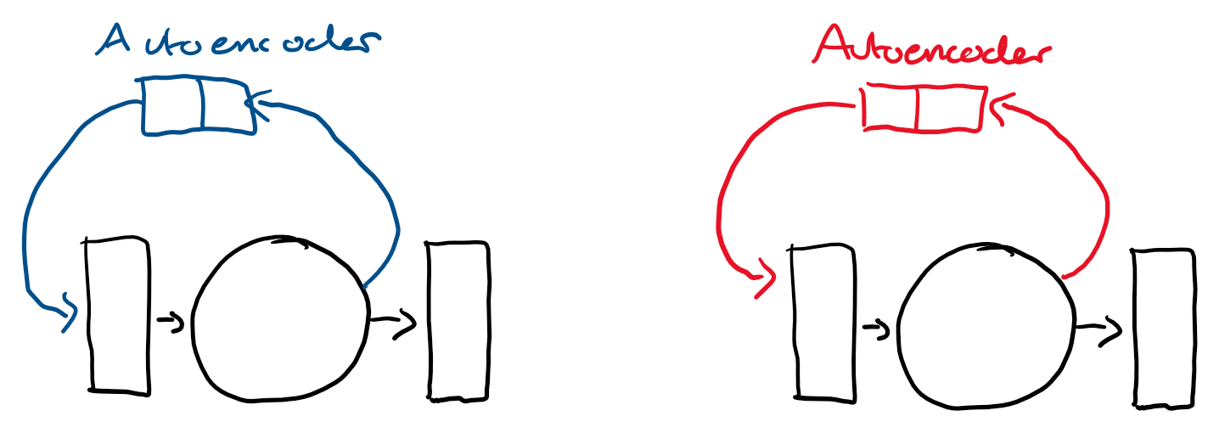
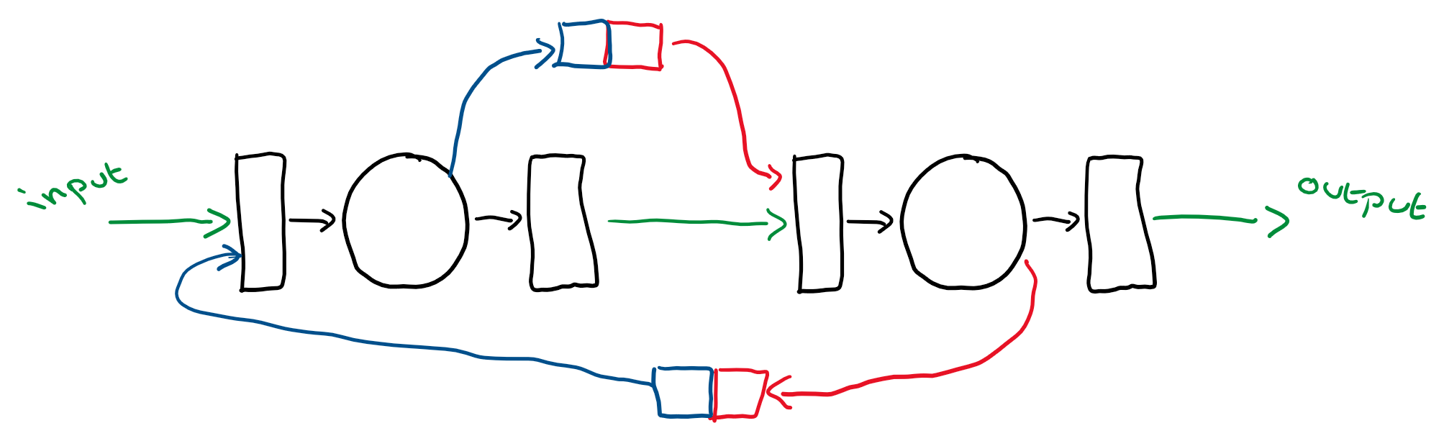
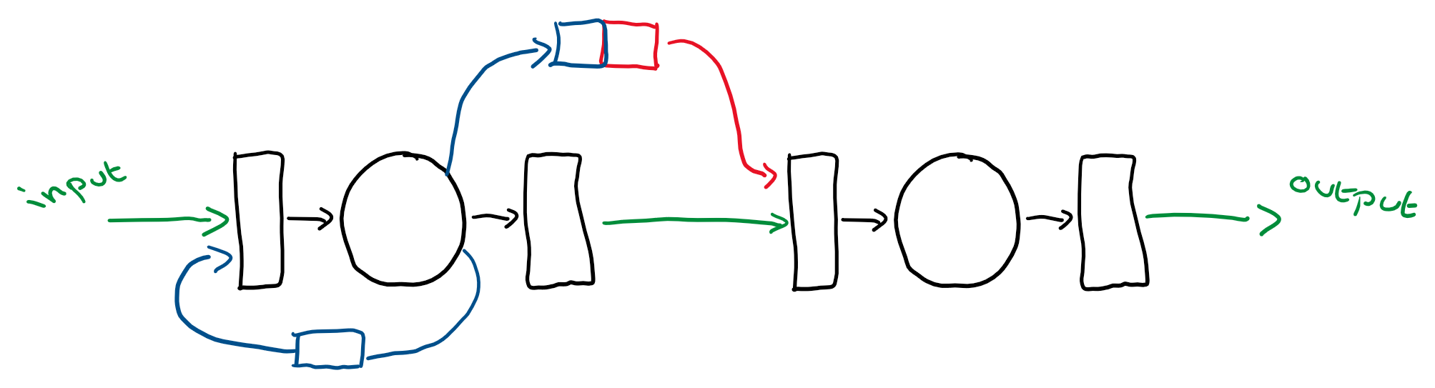
Recap
Standard 30 node
Standard Feedback 30 node
Standard 60 node
Standard Feedback 60 node
Mega ESN, feedback A to B to A
Mega ESN, feedback A to B
To come:
Standard 30 node to Standard 30 node
Standard Feedback 30 node to Standard Feedback 30 node
Standard 60 node to Standard 30 node
Standard Feedback 60 node to Standard Feedback 60 nod

Slide 3
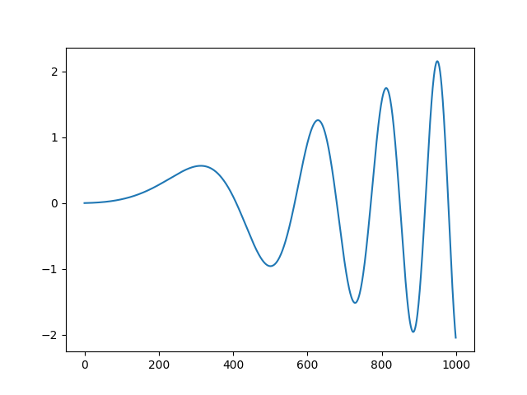
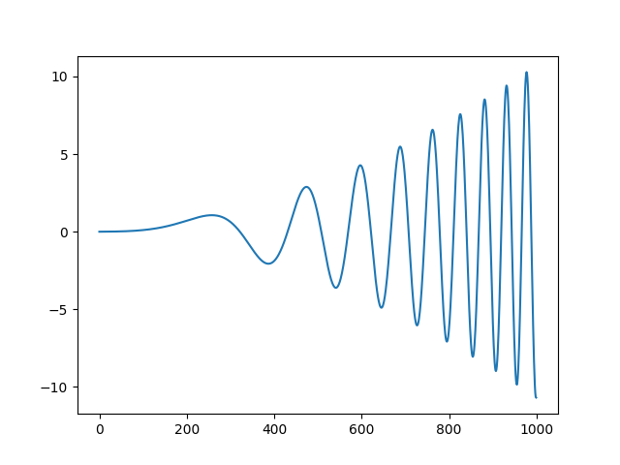
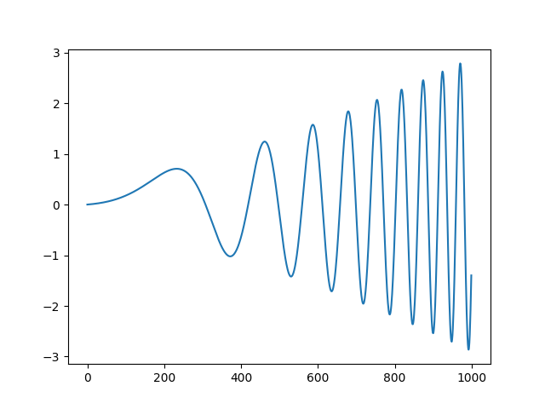
Datasets
y = a sin(theta * b)
a = c ^ 2 + d
B = e ^ 2 + d
c = c + c_change
d = d + d_change
e = d + d_change
A:
c = 0.1 d = 0.1 e = 0.1
c_change = 0.001 d_change = 0.001 e_change = 0.001
B:
c = 0.1 d = 0.1 e = 0.1 c_change = 0.003 d_change = 0.001 e_change = 0.002
C: c = 0.3 d = 0.2 e = 0.1 c_change = 0.001 d_change = 0.001 e_change = 0.002

Slide 4
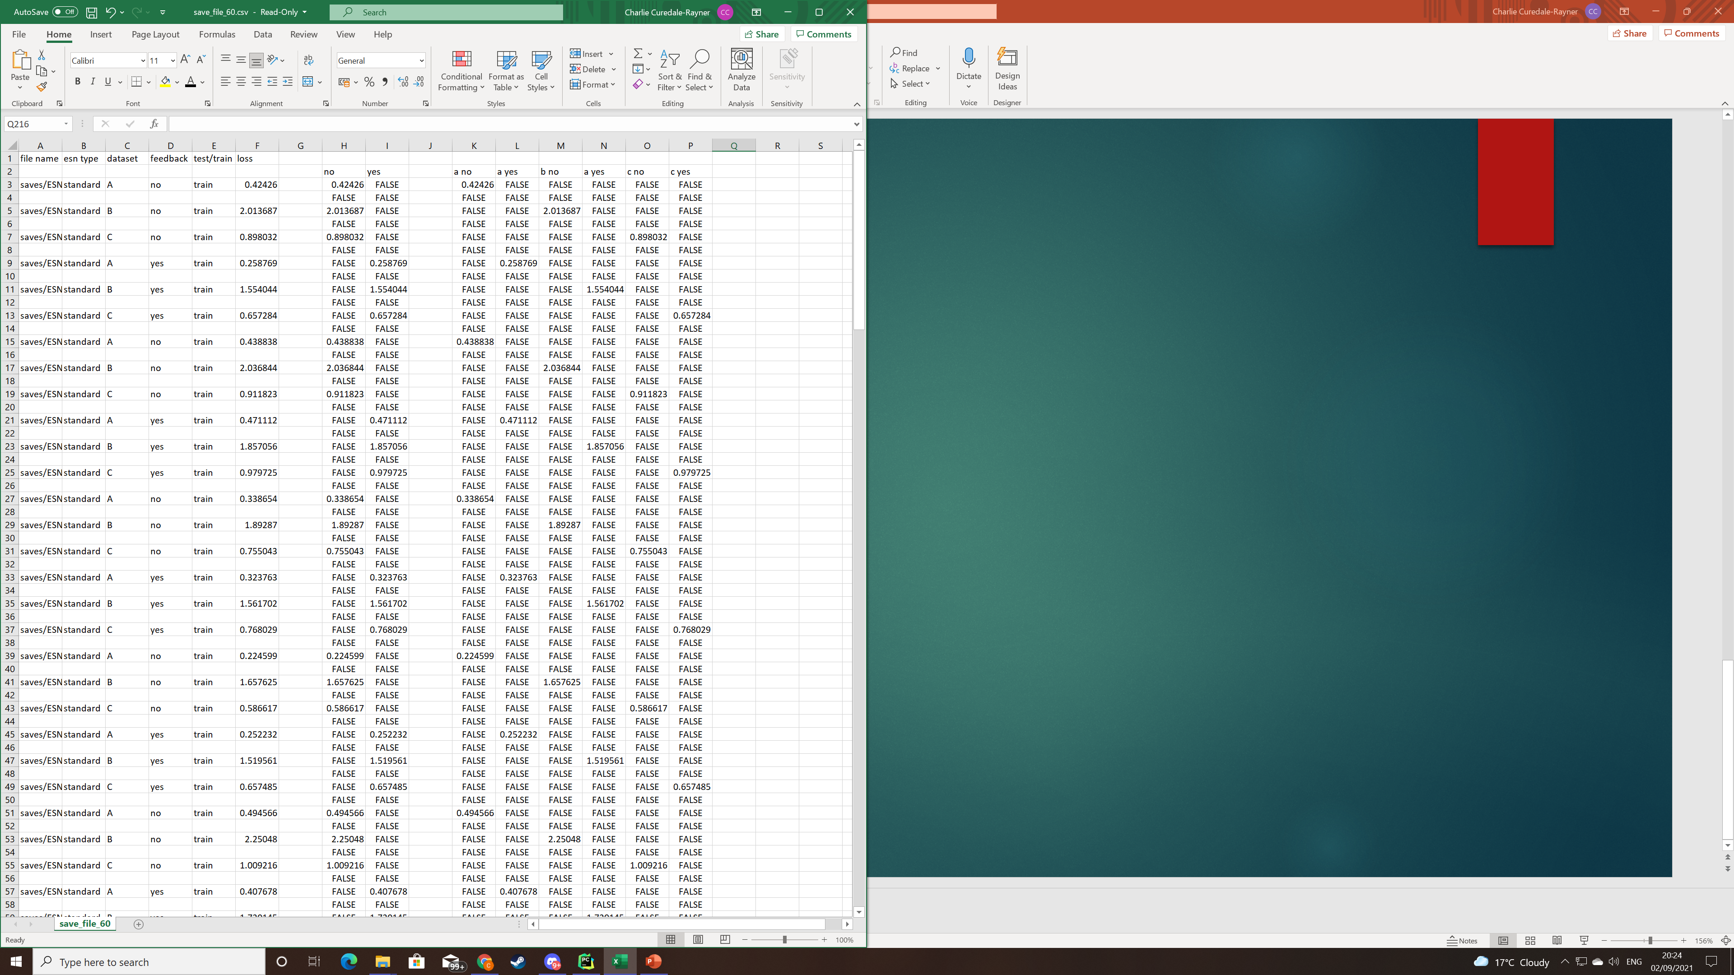
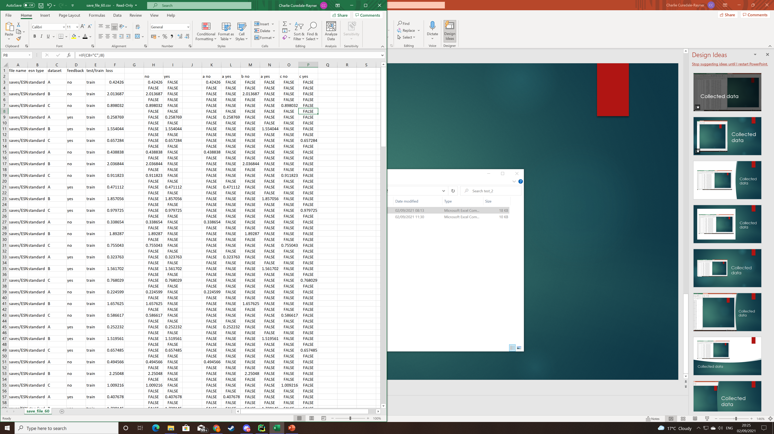
Collected data
First impressions:
Mega ESN A to B to A, seems to be the best network

